Slide 1
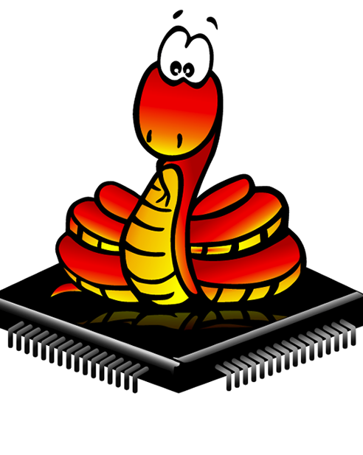
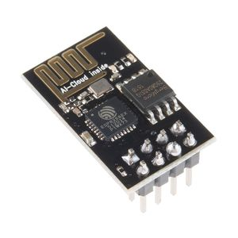

Micropython With ESP8266
for the Internet of Things

Slide 2
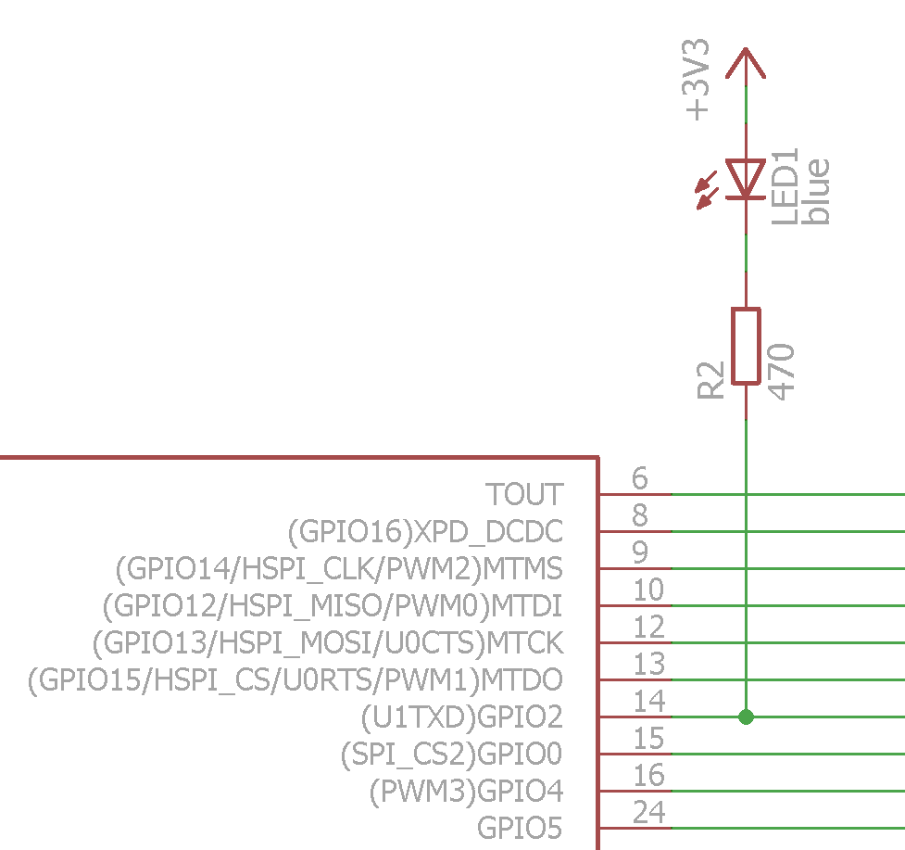
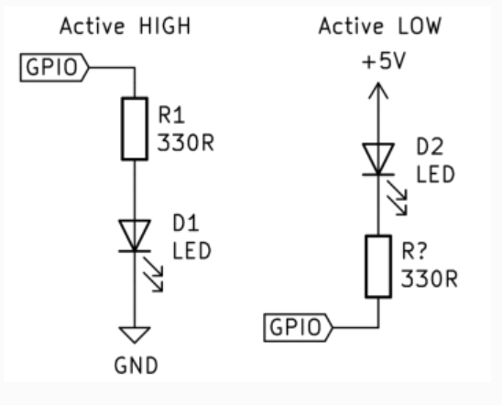
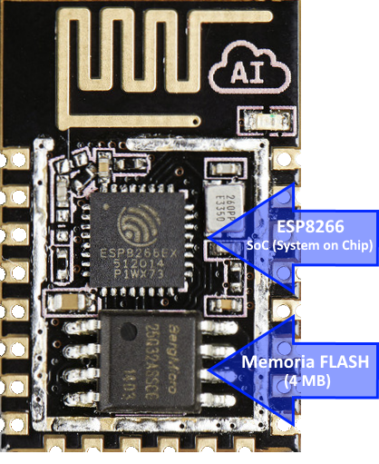
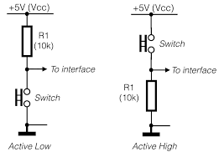

Slide 3
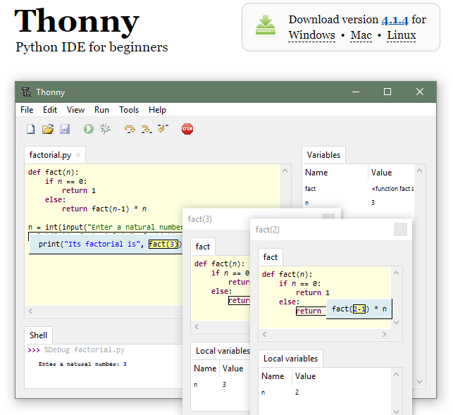
Thonny IDE
https://thonny.org/

Slide 4
The MicroPython Interactive Interpreter Mode (aka REPL)
NodeMCU based ESP8266 has an interrupt feature on its GPIO pins. This function is available on D0-D8 pins of NodeMCU Dev Kit.
1- Auto-indent
2- Auto-completion
3- Interrupting a running program

Slide 5
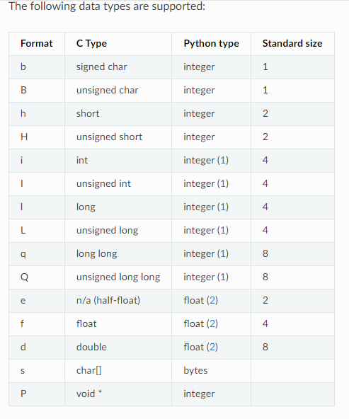

Slide 7
THANK YOU

